Slide 1

Software Architecture
Trivial i1b

Slide 2
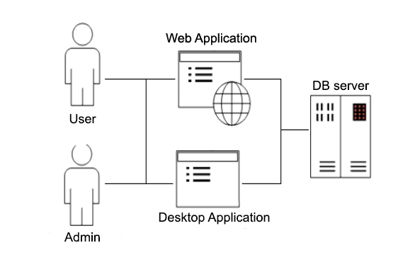
ASW Project
Notes:
The objective of this Project it’s to make a program that has two utilities, to be able to play the trivial game, and as the admin to get information about the users and the games that they play. This functionality it’s going to be the same for the two main applications the desktop one and the web. There’s going to be suport of a DataBase to perform all the necesary persistence.

Slide 3
Objectives
Clearly defined Architecture Style
Use of Attribute Driven Design and Quality Scenarios.
Modularity (between phases, logic, interface… )
Reusability( login between the 2 and 3 part)
Usability. Easy and intuitive interfaces.
Other Quality attributes.

Slide 4
First Deliverable : PARSER
Trivial i1b

Slide 5




Description
Input
Intermediate format
Output
Persistence

Slide 6
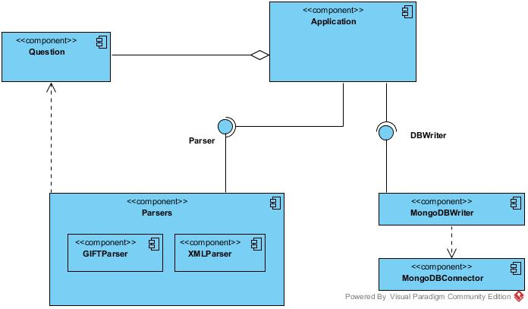
Architecture
Sequential or Batch:
Parser
Processing
Persist
Notes:
Parser lo lleva a cabo parser, pero Processing y Persist lo lleva a cabo DB Writter, que recibe una colección de preguntas y cambia su formato para subirlas a la base de datos.

Slide 7
Quality atributes
Multiple input options for faster usage.
Simple commands make it easy to work with.
Notes:
Input commands make it easy and fast to use, the process could be automated and doesn’t require the user to learn much before being able to work with it.

Slide 8



Tools and technologies
Language
Continuous integration
Version Control Flow
Persistence
Notes:
Parser lo lleva a cabo parser, pero Processing y Persist lo lleva a cabo DB Writter, que recibe una colección de preguntas y cambia su formato para subirlas a la base de datos.

Slide 9
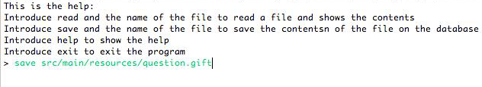
Use example

Slide 10
Second Deliverable : DESKTOP APPLICATION
Trivial i1b

Slide 11





Description
Desktop Application
Register users
User
Admin
Notes:
Explain: This second deliverable its a desktop application to play Trivial. The principal restrictions are that the users have to be registered to play and the admin has access to all the statistics of the games and users.

Slide 12
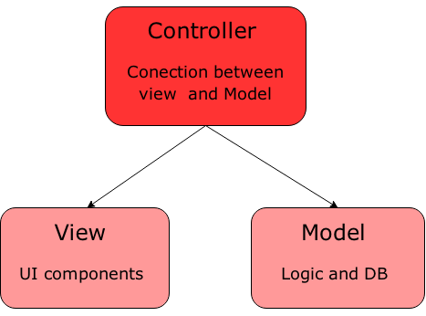
Architecture
Model-View –Controller
Notes:
In this deliverable we fulfil the approach of a MVC. There are three main different parts.
The model that contains the business logic and the records the status. It's independent from the status and the different views.
The controller which is encharge of processing the events of the players and the proper actions.
And the last one the views that are showing the contents of the model.

Slide 13
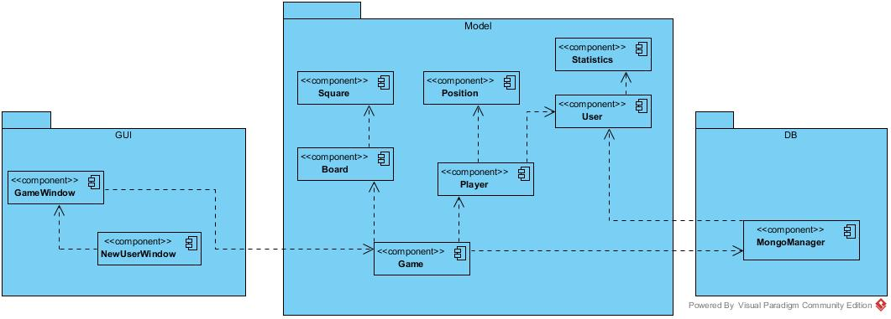
Architecture
Notes:
In our case, this is the application of the MVC. We have there diferenciated modules. The Persistence with the coneccions to Mongo DB, here it’s also included the first deriverable. The bussines logic that it’s the Model package and the Views that are on the gui package.

Slide 14
Quality atributes
User-friendly interface
Look & feel of the application can be changed during execution
Notes:
The application’s interface is similar to the classic game, making it easy to adapt to. The user can change the look of the application while it’s running, for now colors can be changed.

Slide 15






Tools and technologies
Previous ones (Java, Continuous integration, Version Control Flow, Persistence)
Interface plugins.
Testing
Testing and construction
Windows Builder

Slide 16
VIDEO DE ACCION

Slide 17
Third Deliverable : WEB APPLICATION
Trivial i1b

